Slide 1
Adaptations of living things
science

Slide 2
Previous concepts
What are the biotic and abiotic factors in an ecosystem like the African savanna?

Slide 3
What is adaptation?
An ADAPTATION is a characteristic that an organism possesses that suits it to its particular environment.
Adaptations are one way that organisms react to the effects of their abiotic and biotic environments.

Slide 4
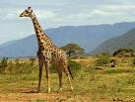
Context
When you look at a giraffe, you may marvel at how efficient it is - it has a long neck that is perfect for eating the leaves from the tops of high trees. The long neck is also good for seeing far in the grassy savannah, so giraffes make good lookouts for predators like lions and cheetahs. The giraffe's long neck is an example of an ADAPTATION.

Slide 5
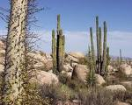
Adaptations of plants
DESERT plants must have adaptations to help them conserve water. A desert receives less than 25 cm of rain every year. The days are scorching hot, and the nights can get very cold. The soil in a desert is very sandy or very rocky -not great for plants.
However, there are many plants that can grow in the desert because they have adapted to those conditions.

Slide 6
What plant do you know that cansurvive in the desert?

Slide 7
The Cactus
The cactus has a stem that has large chamber to hold water, so when it does rain in the desert, the cactus can store the water for later use. The "skin" of a cactus is waxy and waterproof, and this prevents evaporation of water from happening. Instead of leaves, a cactus has prickly needles which helps to ward off animals that might be interested in drinking the cactus' water.

Slide 8
Animal Adaptations
There are three kinds of animal adaptations:
STRUCTURAL ADAPTATIONS
BEHAVIORAL ADAPTATION
FUNCTIONAL ADAPTATION

Slide 9
STRUCTURAL ADAPTATIONS
deal with the animal's physical body, such as the way it is shaped, or colored. Camouflage is an important structural adaptation that enables animals to escape from predators, or hide and attack prey.

Slide 10
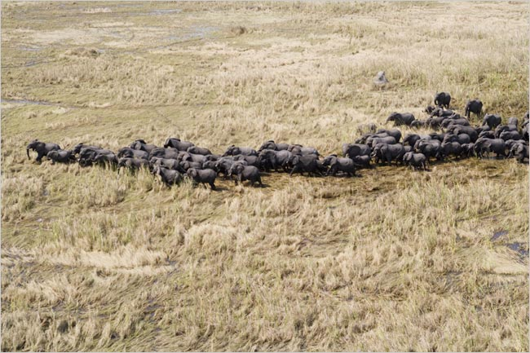
BEHAVIORAL ADAPTATION
If the animal acts a certain way that increases their chances of survival, it is called a BEHAVIORAL ADAPTATION. Some animals play dead in order to trick predators - when the predator slow down its attack, the animal can get away. Migration is a behavioral adaptation
-without it, many animals would freeze to death in the winter.

Slide 11
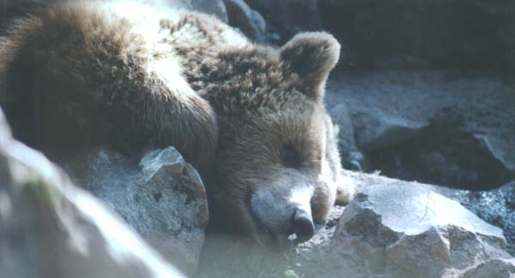
FUNCTIONAL ADAPTATION
A FUNCTIONAL ADAPTATION is related to life functions, such as reproduction and metabolism. Hibernation is a body's response to seasonal change, and allows some animals to survive through the winter. Desert birds lay eggs during the short rainy season so that their young have enough food.

Slide 12
Desert adaptations
DESERT animals must live in extreme heat and dryness, and they escape the hot air during the day by burrowing into the sand. Lizards have upturned nostrils and shields over their eyes to protect them from the sand. Lizards also have thick leathery skin to prevent water loss. These are all structural adaptations.
A kangaroo rat can survive on the water it obtains from its food, and camels can retain water for long periods of time. Some desert mammals can cool the air in their nostrils and condense the moisture in their breath. Animals that need water always live close to a water source.

Slide 13
What other adaptations do you know?

