Slide 1
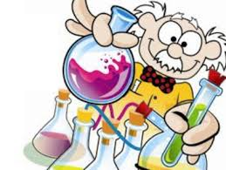
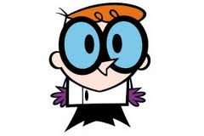
LAB SAFETY RULES

Slide 2
LETS TALK
What’s a laboratory?
Do you like to go to the laboratory? Why?
What kind of activities can be developed in a laboratory?
Why do you need to know the safety rules on the laboratory?

Slide 3
GENERAL GUIDELINES

Slide 4
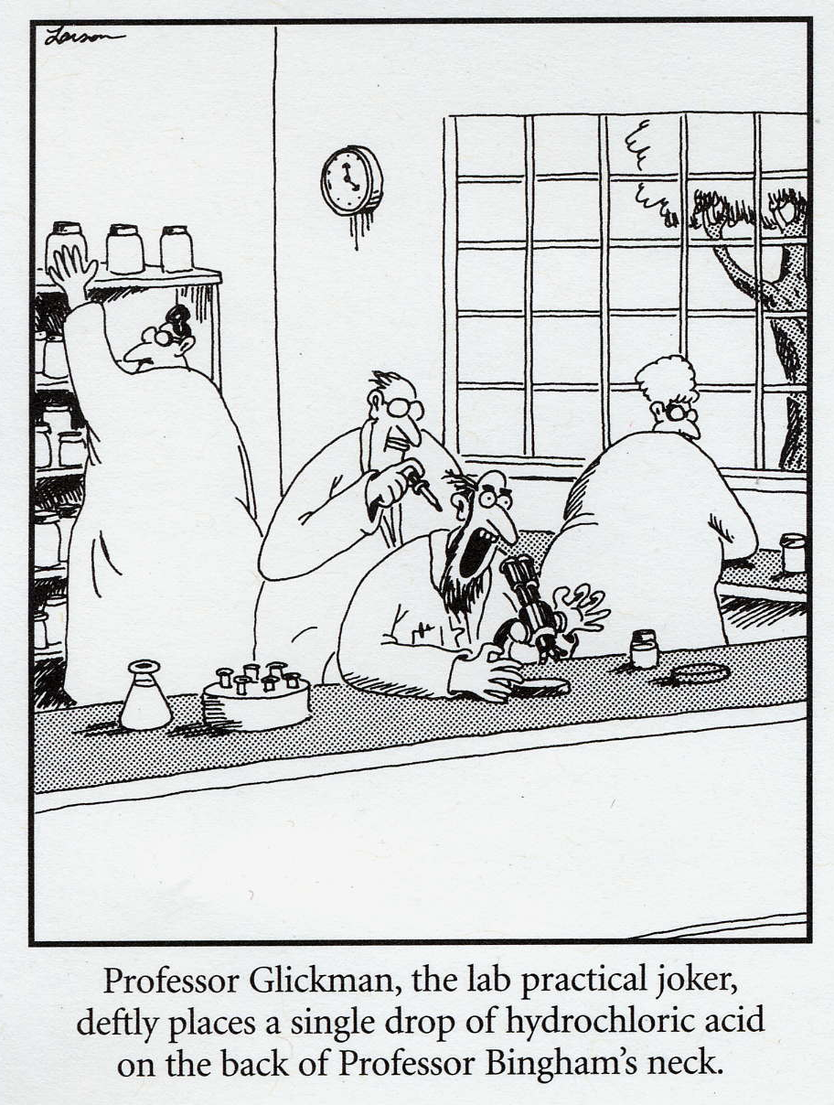
Conduct yourself in a responsible manner at all times in the laboratory.

Slide 5
2. Follow all written and verbal instructions carefully. If you do not understand a direction or part of a procedure, ASK YOUR TEACHER BEFORE PROCEEDING WITH THE ACTIVITY.

Slide 6
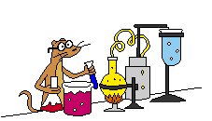
3. Never work alone in the laboratory. No student may work in the science classroom without the presence of the teacher.

Slide 7
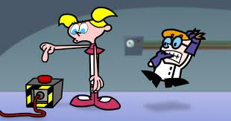
4. When first entering a science room, do not touch any equipment, chemicals, or other materials in the laboratory area until you are instructed to do so.

Slide 8
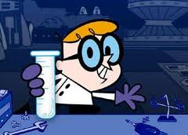
5. Carefully follow all instructions, both written and oral. Unauthorized experiments are not allowed.

Slide 9
6. Do not eat food, drink beverages, or chew gum in the laboratory. Do not use laboratory glassware as containers for food or beverages

Slide 10
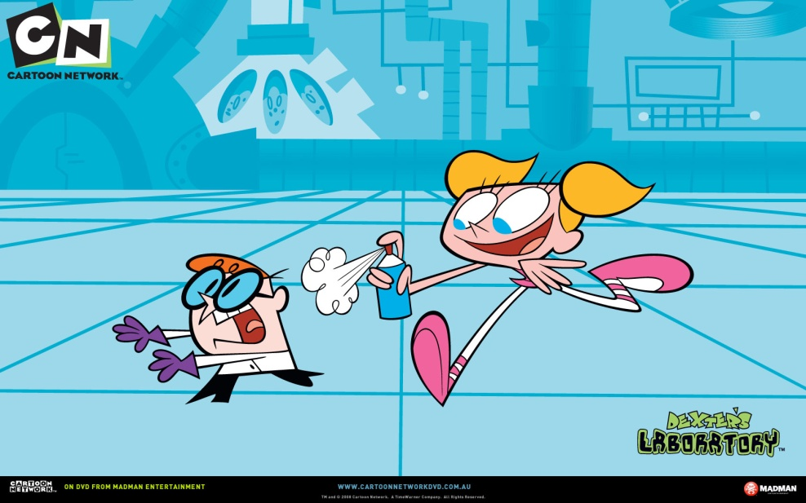
Never fool around in the laboratory.
Horseplay, practical jokes, and pranks are dangerous and prohibited.

Slide 11
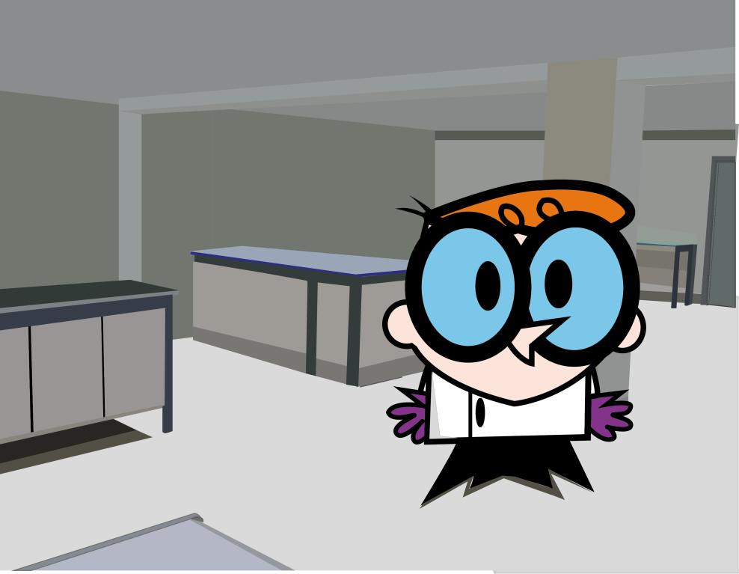
8. Work areas should be kept clean and tidy at all times.

Slide 12
9. Be alert and proceed with caution at all times in the laboratory. Notify the teacher immediately of any unsafe conditions you observe.

Slide 13
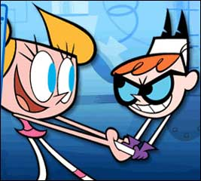
10. Do not wander around the room, distract other students, startle other students or interfere with the laboratory experiments of others.

Slide 14
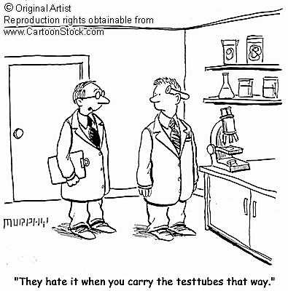
11. Handle glassware carefully

Slide 15
12. If you do not understand how to use a piece of equipment, ASK THE TEACHER FOR HELP!

Slide 16
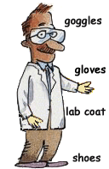
CLOTHING

Slide 17
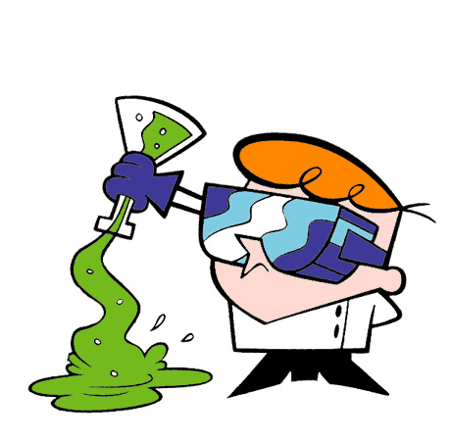
13. If the experiment requires the use of safety goggles and gloves make sure that you use them.

Slide 18
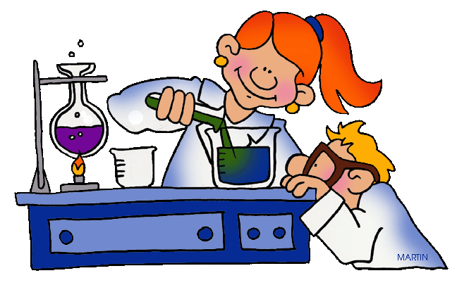
14. Keep all long hair tied back

Slide 19
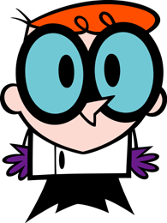
15. A lab coat should be worn during laboratory experiments.

Slide 20
Remember:

Slide 21
Lets Work
Make a group of 3 people.
Read the information on the assigned slide.
Perform a little stand up, where you develop the topic written on it.
You will have 5 minutes to the performance
Have fun developing the performance.

Slide 22
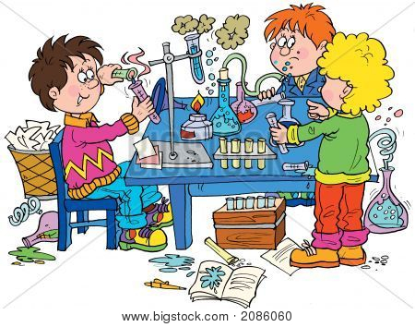
1. What could happen if you don´t use the safety devices in the lab ?

Slide 23
2. What cold happen if you don´t follow your teacher’s instructions?

Slide 24
3. Why girls must wear a pony tale into the lab?

Slide 25
4. What could happen if you leave a sandwich on your laboratory table and then you put it back into your mouth?

Slide 26
5. What could happen if you play with your partners into the lab?

Slide 27
6. What could happen if you work without your teacher’s supervision in the lab?

Slide 28
7. What could happen if you work without your teacher’s supervision in the lab?

Slide 29
8. What could happen if you left a glassware on the edge of a lab table?

Slide 30
9. What could happen if you have a mess in your work area?

Slide 31
10. What would you do if there is an emergency during the lab practice?

Slide 32
Learn more at.
http://nobel.scas.bcit.ca/debeck_pt/science/safety.htm
http://www.kids-science-experiments.com/lab-rules.html
http://www.ehow.com/facts_5566032_lab-safety-rules-kids.html

