Slide 1
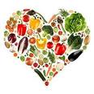

Slide 2
Let’s talk
Why do we eat food?
How many kinds of food you know?
What foods do you like the most?
What do you usually eat for (breakfast)?
What is junk food?
What is healthy food?
How can you ensure a balanced alimentation?

Slide 3
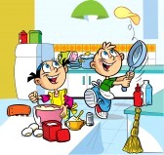
What is food

Slide 4
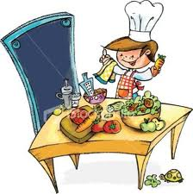
Is any substance consumed to provide nutritional support for the body. It is usually of plant or animal origin, and contains essential nutrients, such as (carbohydrates, fats, proteins, vitamins, minerals)

Slide 5
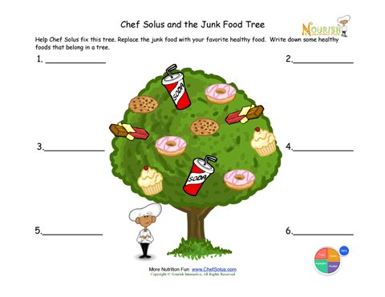

Slide 6
Food Classification
According to the origin

Slide 7
According to its origin, food can be classified in:
Animal Foods
Vegetable Foods
This Kind of food comes from animals. Can be processed or unprocessed
This Kind of food is produced by plants in natural way, or by processing them
Meat, fish, shellfish, crustaceans, eggs, milk and its products, animal fats, gelatin
Cereals, vegetables proper, fruits, sugars, vegetable oils

Slide 8
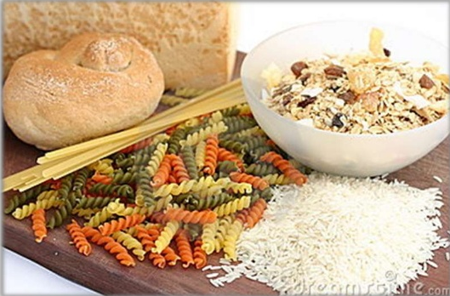
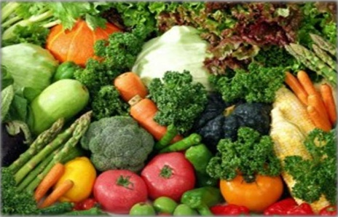
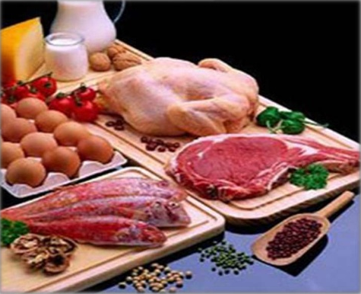
Food Classification
According to the Benefits

Slide 9
According to the benefits food give us, it is classified as follows:
Energy giving foods
Body building foods
Protective foods
This group gives energy to the body
These foods allow us to grow and repair tissues in bones, tissues, skin, etc
Include food to the protection of the body and defense against diseases
Nutrients
Nutrients
Nutrients
Carbohidrates and oils and fats
Animal and plant proteins
Minerals and vitamins
Examples
Examples
Examples
Cereals like rice and wheat / Fat-ghee and oil / Sugar
Milk / Meat/ Eggs/ beans/ grains
Vegetables specially green leafy/ fruits

Slide 10
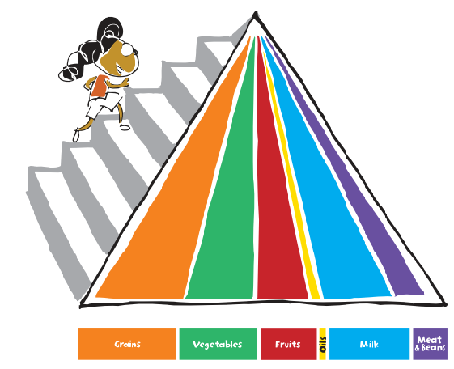
The food pyramid

Slide 11
The Food Guide Pyramid is one way for people to understand how to eat healthy. A rainbow of colored, vertical stripes represents the five food groups plus fats and oils. Here's what the colors stand for:
The U.S. Department of Agriculture (USDA) changed the Pyramid in 2005 because they wanted to do a better job of telling Americans how to be healthy. The agency later released a special version for kids. Notice the hiker climbing up the side? That's a way of showing kids how important it is to exercise and be active every day. In other words, play a lot! The steps are also a way of saying that you can make changes little by little to be healthier. One step at a time, get it?

Slide 12
The Pyramid Speaks
Let's look at some of the other
messages this symbol is trying to
send:
Eat a variety of foods.
A balanced diet is one that
includes all the food groups.
In other words, have foods from
every color, every day.
Eat less of some foods, and more of others. You can see that the bands for meat and protein (purple) and oils (yellow) are skinnier than the others. That's because you need less of those kinds of foods than you do of fruits, vegetables, grains, and dairy foods.

Slide 13
You also can see the bands start out wider and get thinner as they approach the top.
That's designed to show you that not all foods are created equal, even within a healthy food group like fruit. For instance, apple pie would be in that thin part of the fruit band because it has a lot of added sugar and fat. A whole apple — crunch! —
would be down in the wide part because you can eat more of those within a healthy diet.

Slide 14
Every color Every day: The colors orange, green, red, yellow, blue, and purple represent the five different food groups plus oils. Remember to eat foods from all foods group every day.
Make choices that are right for you: MyPyramid.gov is a Web site that will give everyone in the family personal ideas on how to eat better and exercise more.

Slide 15
Take one step at a time: You don’t need to change overnight what you eat and how you exercise. Just start with one new, good thing, and add a new one every day.

Slide 17
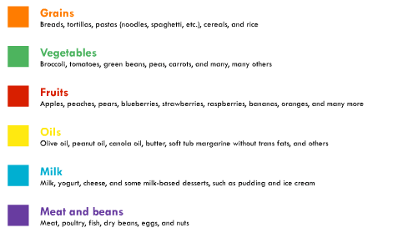

Slide 18
Grain Group foods give us carbohydrates (car-bo-hi-drate). Carbohydrates give us the energy we need to play, learn, sleep and keep our bodies running 24-7!
Grain Group Foods come from many different grain plants: wheat, oats, rye, barley and rice. "Whole-grains" like whole-wheat bread, also provide fiber and other substances that help keep us healthy. Fiber also helps us digest our food.
Try to choose whole-grain foods from this group.
There are many foods to choose from in the Grain Group: bread: white, wheat, rye, buns, rolls, muffins, bagels • cereals: hot and cold • rice: all kinds • pasta: spaghetti, macaroni, noodles • tortillas • crackers • pancakes

Slide 19
Is it easier for you to see in the dark or the daylight? For most people it's easier in the daylight! Foods in the Vegetable Group give us vitamin A that helps us see in the dark. Vitamin A also helps to keep our skin healthy.
Vegetables also provide:
Vitamin C, which helps heal cuts and bruises and fight infections.
Fiber, which helps us digest our food.
Substances called "phytochemicals" (fight-o kem ick-kals) that help prevent diseases.
Some foods in the Vegetable Group are: broccoli • cauliflower • corn • peas • green beans • lettuce • mushrooms • celery • carrots • white potatoes and sweet potatoes • juices made from vegetables: tomato juice, carrot juice

Slide 20
Fruit Group foods provide vitamin C. Vitamin C helps our body heal cuts and bruises and fight infections!
Fruit Group foods also provide:
Vitamin A, which helps us see in the dark and helps keep our skin healthy.
Fiber, which helps us digest our food.
Substances called "phytochemicals" (fight-o kem ick-kals) that help prevent diseases.
Some of the foods in the Fruit group are: apples • oranges • bananas • pears • grapes • kiwi • berries: strawberries, blueberries, raspberries • melons: watermelon, cantaloupe, honeydew • pineapple • papaya

Slide 21
Did you know your body has 206 bones that are alive and growing? Believe it or not, you'll eventually have 32 permanent teeth! Milk Group foods provide calcium that helps build strong bones and teeth. They also provide other important nutrients, including protein, vitamin A, vitamin D, and B vitamins.
Calcium helps:
strengthen bones, which are growing stronger and longer
stop bleeding if you get cut or bruised
muscles contract and relax
Build strong bones with these foods in the Milk Group: milk • flavored milk like strawberry, banana, chocolate • yogurt • cheese: string, cheddar, American and others • pudding • frozen yogurt

Slide 22
Stand up and take a step. You just used 54 muscles! Your muscles hold your bones together and make them move. Meat Group foods help build strong muscles. Foods in this group provide protein and iron.
Iron is important because it:
carries oxygen to all parts of your body
helps prevent infections and anemia that can make you feel tired
helps your body make energy to get you through busy days
Build muscles with these Meat Group foods: beef • pork • chicken and turkey • fish • dried beans and peas • peanut butter • eggs • nuts

Slide 23
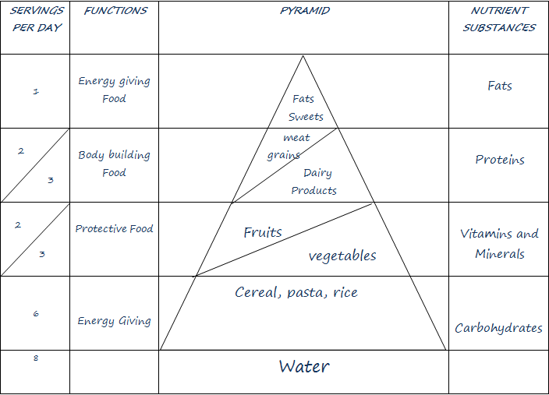
Energy giving food
Fats
1
Fat and sweets
2
Body building food
Meat and beans
Proteins
3
Diary products
2
Protective food
Vitamins and minerals
fRUITS
3
Vegetables
Energy giving food
Carbohidrates
6
GRAINS
8
Water

Slide 24
1. What do the color bands on the Food Guide Pyramid represent?
a. A rainbow
b. Vitamins and minerals
c. Different food groups
2. Some color bands are bigger than others. Why?
a. To show that should eat oranges more than any other food?
b. To show that you should eat more of some food groups and less of others
c. The person who drew the pyramid thought it looked pretty that way
3. Who can follow the Food Guide Pyramid?
a. Only people older than 18
b. Only vegetarians
c. Most people older than 2
4. The yellow band of the Pyramid stands for what?
a. Oils
b. Grains
c. Vegetables
5. The green band on the Pyramid represents which food group?
a. Fruits
b. Vegetables
c. Milk

Slide 25
6. The red band on the Pyramid stands for which group?
a. Grains
b. Fruits
c. Meat and beans
7. The purple band on the Pyramid represents which foods?
a. Meat and beans
b. Milk
c. Oils
8. The orange band on the Pyramid stands for which food group?
a. Oils
b. Fruit
c. Grains
9. He blue band on the Pyramid represents which food group?
a. Vegetables
b. Milk
c. Meat and beans
10. Why is the stick figure climbing the side of the Pyramid?
a. The Pyramid’s elevator is broken
b. To show that exercise is an important part of healthy living
c. He wants to slide down the other side

Slide 26
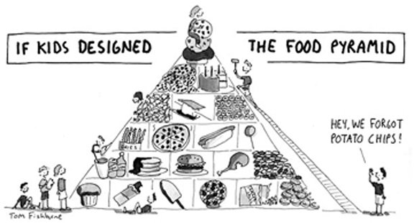

Slide 27
You can find fun games and activities about the Food Pyramid at:
http://www.nutritionexplorations.org/kids/nutrition-pyramid.asp
http://www.nourishinteractive.com/nutrition-education-printables/category/5-food-groups-kids-healthy-eating-learning-sheets
http://www.nourishinteractive.com/nutrition-games/childrens-educational-healthy-food-games/eating-healthy-meals-dietary-habits

