Slide 1
BIOMES OF THE WORLD

Slide 2
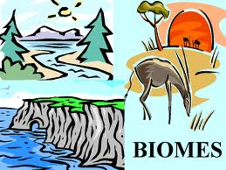
What is a Biome?
A biome is a large area
with similar flora, fauna,
and microorganisms. Most
of us are familiar with the
tropical rainforests, tundra
in the arctic regions, and
the evergreen trees in the coniferous forests.
Each of these large communities contain species that are adapted to its varying conditions of water, heat, and soil.
For instance, polar bears thrive in the arctic while cactus plants have a thick skin to help preserve water in the hot desert.

Slide 3
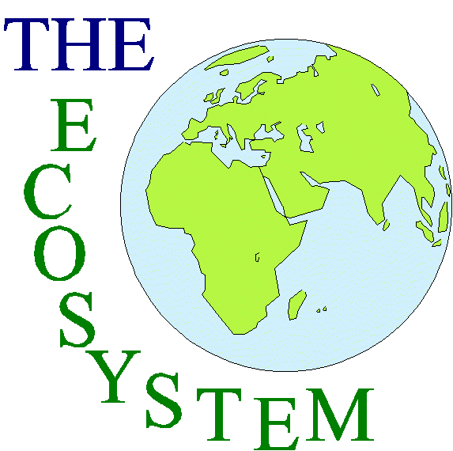
What is an Ecosystem?
Most of us are confused when it
comes to the words ecosystem
and biome. What's the difference?
There is a slight difference between
the two words. An ecosystem is
much smaller than a biome.
Conversely, a biome can be thought of many similar ecosystems throughout the world grouped together.
An ecosystem can be as large as the Sahara Desert, or as small as a puddle or vernal pool. Ecosystems are dynamic interactions between plants, animals, and microorganisms and their environment working together as a functional unit. Ecosystems will fail if they do not remain in balance.

Slide 4
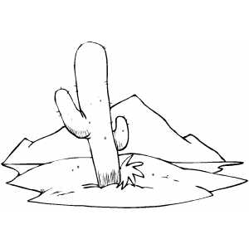
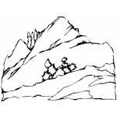
The Major Biomes:
Rain Forest
Taiga
Tundra
Grassland
Desert
Marine
Freshwater

Slide 5
Find the major Biomes.
|
J | A | G | S | M | I | D | K | F | O | N | G | H | A | R | N | T
C | R | A | I | N | F | O | R | E | S | T | N | I | C | L | E | A
K | F | S | F | R | U | V | I | F | D | N | D | T | M | M | C | M
E | F | R | E | S | H | W | A | T | E | R | S | L | P | A | I | G
O | T | W | P | Z | U | Q | Y | V | O | C | L | E | E | P | O | N
A | L | U | S | K | D | J | E | X | N | T | R | U | E | I | G | D
I | J | E | N | R | U | T | L | U | V | A | R | E | M | M | I | N
R | A | F | R | D | T | X | Q | R | T | F | Y | J | A | I | D | A
O | B | N | I | E | R | H | D | E | O | L | G | R | U | X | N | Z
P | E | S | E | R | G | A | D | R | F | R | I | T | H | E | A | S
A | D | D | N | U | L | E | E | S | S | N | M | R | K | S | L | D
F | O | R | E | T | S | S | G | O | E | D | N | E | T | D | S | G
O | I | S | E | I | T | R | P | S | E | B | E | S | B | I | S | M
S | O | T | D | E | A | C | E | C | C | M | A | E | E | L | A | I
V | E | U | M | S | T | A | I | G | A | L | S | D | V | M | R | E
S | O | M | G | M | S | A | P | T | I | D | O | H | E | Q | G | C
S | E | M | T | D | M | Q | K | P | L | E | E | T | V | A | M | A

Slide 6
Go to:
http://www.youtube.com/watch?v=WZGCZY47YS0

Slide 7
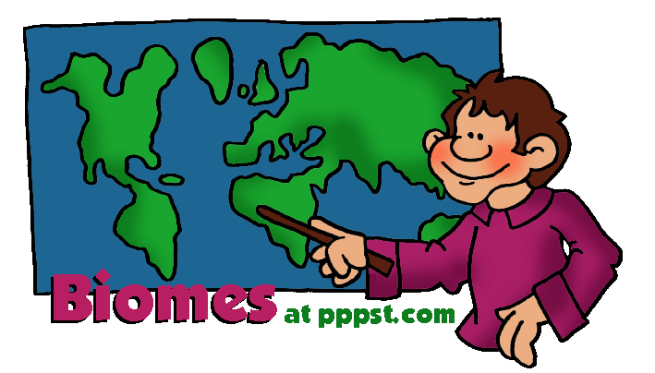
Land biomes

Slide 8
TROPICAL RAIN FOREST
Main Characteristics:
Flora: many tall, rain loving trees that form a canopy for other wildlife to grow below: Banyam Tree
Location: located between the tropic of cancer and the tropic of capricon. Mostly in Latin América, sutheast Asia and the pacific Islands, and West Africa.
Fauna: Amazing diversity of animals and wildlife: Brazilian Tapir, lemur, toucan, poison frog.
Climate: Very lush and wet, with 80-100 inches of rain a year.
Warm all year round, with temperatures between 75 and 80 degrees Farenheit.

Slide 9
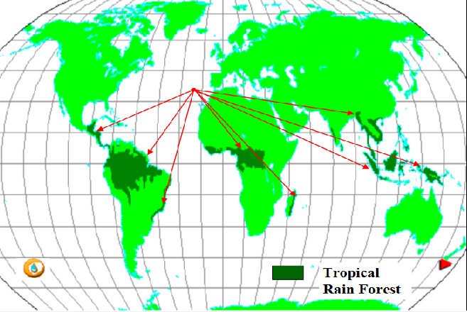

Slide 10
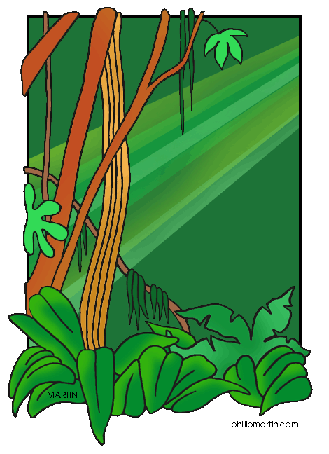
Tropical rainforests are one of nature's treasures, and many of them are now at risk. We have already destroyed half of the world's original tropical rainforests! Just in a few decades, we can possibly witness the complete elimination of the world's rainforests.
Important Facts
Amazon rainforests produce about 40% of the world's oxygen One in four pharmaceuticals comes from a plant in the tropical rainforests 1400 rainforest plants are believed to offer cures for cancer 40% of tropical rainforests have already been lost in Latin America and Southeast Asia

Slide 11
TAIGA
Main Characteristics:
Flora: There are many coniferous trees such as sprunce and fir.
Location: Largest biome, located between 50 degrees latitude north and the artic circle .
Fauna: There are a lot of big carnivores here. Red Fox, black bear , Bob cat.
Climate: Freezing cold for six months of the year.
Temperature ranges from 65 to 70 degrees Fahrenheit.

Slide 12
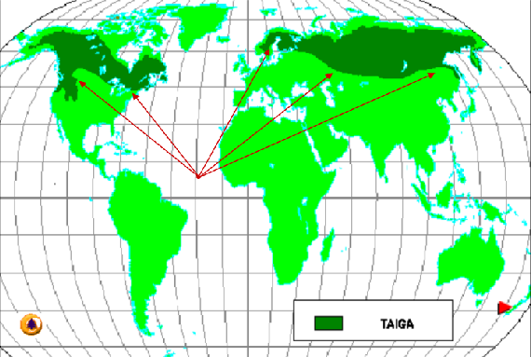

Slide 13
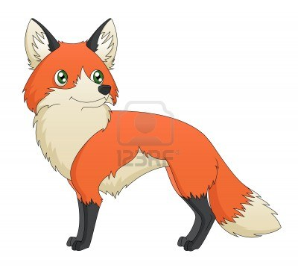
Important Facts
The taiga is prone to wildfires. Because of this, many trees have adapted to this by growing thick bark, which can protect the tree from a mild fire. The world's oldest trees can be found in the taiga. The bristlecone pines in California are a prime example. One of them is 4,600 years old! The trunks of the conifer trees are used to produce paper. The taiga has fewer plant and animals species than most other biomes. The taiga covers 11% of the earth. The Cree Indians have lived in the North American Taiga forest for centuries.

Slide 14
TEMPERATE DECIDUOUS FOREST
Main Characteristics:
Flora: The great amount of rainfall helps to support large trees and much plant life. Ginkgo
Location: Located primaly in the eastern half of the United States, Canada, Europe, parts of Russia, China and Japan.
Fauna: Great diversity of animals, many omnivores and several birds. Turkey, Vale, black bear.
Climate: has distinct winter, spring, summer and fall. Verage temperature: about 50 degrees Fahrenheit.

Slide 15
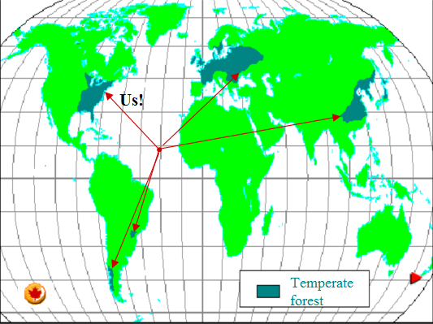

Slide 16
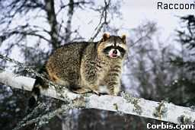
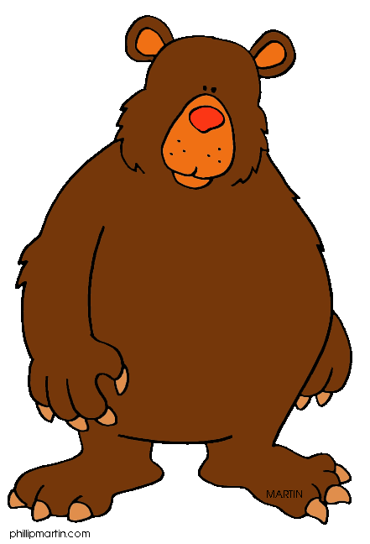
Important Facts
The temperate deciduous forest is a biome that is always changing. Because the soil is very fertile and hardwood trees are good for building, this biome has some of the world's largest population centers in it. Insects, spiders, slugs, frogs, turtles and salamanders are common. Humans have often colonized places in the temperate deciduous forest, as well as harvesting the wood for timber. As a result, less than a quarter of the original forests are left. A deciduous forest has trees that lose most of their foliage seasonally.

Slide 17
TUNDRA
Main Characteristics:
Flora: Not too much plant diversity. Mosses, Shrubs, wildflowers.
Location: Located around the North Pole
Fauna: Polar Bear, Gyrfalcon, Caribou, fox.
Climate: -60 to 32 degrees Farenheit. The soild is frozen, and the permafrost exist within a meter of the surface.

Slide 18
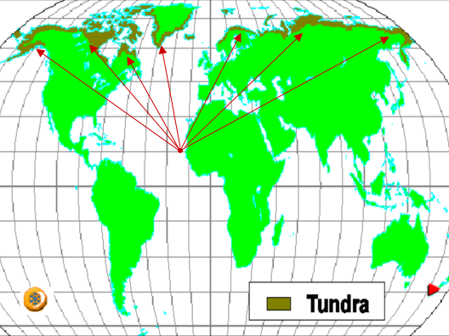

Slide 19
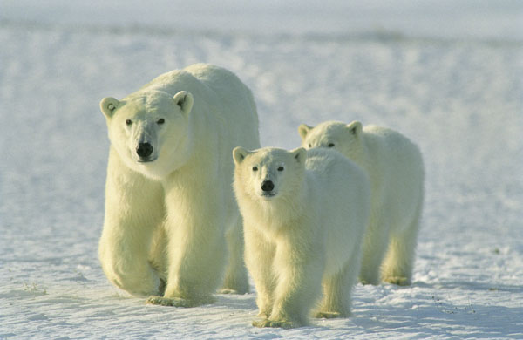
Important Facts
The word Tundra means "Tree less plain" The tundra is kown as the second most deadly environment in the world. The tundra is considered the coldest of all biomes. Only the top layer in the soil can thaw in the summer, which doesn't allow plants requiring a deep root structure to grow Some plants that live in the tundra are arctic moss, arctic willow, bearberries, caribou moss, and pasque flowers.

Slide 20
GRASSLAND
Main Characteristics:
Flora: Wilde open spaces with few trees or bushes. Deep, fertile soil that takes well to crops.
Location: Often located between forests and deserts.
Fauna: giraffe, zebra, wild beast, deer, llama.
Climate: The climate typically consists of warm, wet summers followed by cold, dry winters with heavy frosts.

Slide 21
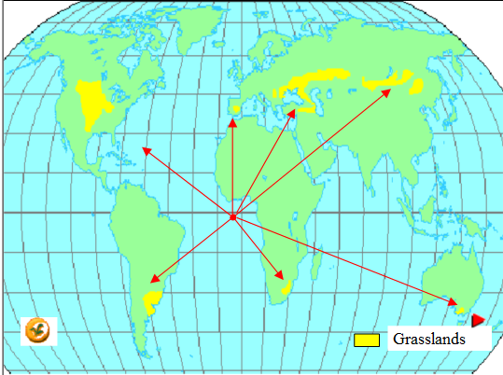

Slide 22
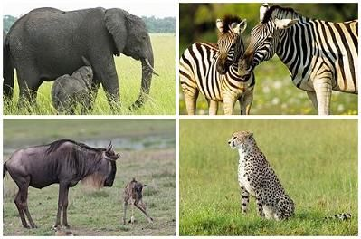
Important Facts
Were once located on each continents except Antarctica. Now mostly converted to farm land or suburbs. The grass land doesn't grow many trees due to high winds and fires. There are 3 types of Grasslands; tall, short, and mixed. Grasslands are threatened by fires because there is not a lot of rainfall so in the summer it gets very hot and the grass can catch on fire and spread very quickly. Eurasia's grassland is the largest grassland in the world. In some African grasslands there is a big problem with people shooting animals for fur.

Slide 23
DESERTS
Main Characteristics:
Location: Found in bands along 30 degrees latitude north and 30 degrees latitude south.
Fauna: Fat sand rat, vulture, Addax
Climate: Less than 10 inches of precipitation per year. Can reach temperatures of 100+ Fahrenheit in the day but fall to the 40s or 50s at night due to the lack of humidity.
Flora: Yucca, Barrel cactus, Dragon tree,

Slide 24
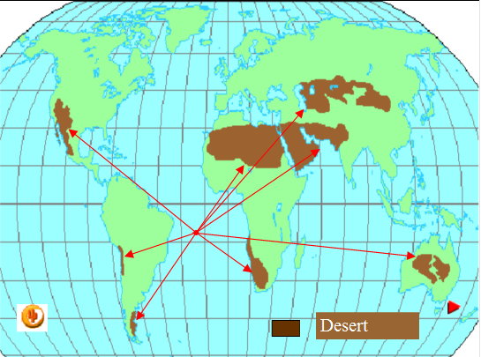

Slide 25
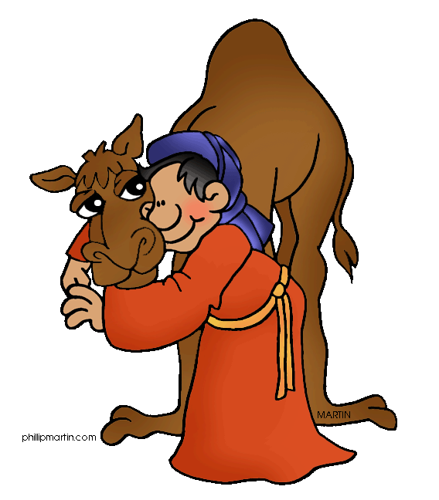
Important Facts
Largest deserts: Sahara, Gobi, Kalahari, Great Victoria and Great Sandy. Ehen it does rain, there is usually a huge downpour, and desert flowers bloom. There are a number of different definitions to describe a desert but they are typically areas that receive extremely low amounts of rain. Around one third of the Earth's surface is covered in deserts. Deserts often contain large mineral deposits. Deserts can be good locations to farm solar energy.

Slide 26
Water biomes

Slide 27
Scientist group terrestrial biomes according to climate and vegetation.
Aquatic Ecosystems are grouped instead by:
Water salinity
Deph
Wheter the water is moving or standing

Slide 28
Freshwater Biomes
Freshwater is defined as having a low salt concentration — usually less than 1%. Plants and animals in freshwater regions are adjusted to the low salt content and would not be able to survive in areas of high salt concentration (i.e., ocean). There are different types of freshwater regions:
Ponds and lakes
Streams and rivers
Wetlands
http://www.ucmp.berkeley.edu/exhibits/biomes/freshwater.php

Slide 29
Lakes and ponds
Lakes are the deepest of fresh water systems
Lakes are fed by underground aquifer or stream
Ponds are fed by rainfall and may be seasonal.
Lakes and ponds are divided into three different “zones” which are usually determined by depth and distance from the shoreline.
The littoral zone: This zone is the warmest. It sustains a fairly diverse community, which can include several species of algae, rooted and floating aquatic plants, grazing snails, clams, insects, crustaceans, fishes, and amphibians.
The limnetic zone is well-lighted (like the littoral zone) and is dominated by plankton, both phytoplankton and zooplankton.
The profundal zone. This zone is much colder and denser than the other two.

Slide 30
Streams and rivers
Main Characteristics:
These are bodies of flowing water moving in one direction.
they get their starts at headwaters, which may be springs, snowmelt or even lakes, and then travel all the way to their mouths, usually another water channel or the ocean.
The characteristics of a river or stream change during the journey from the source to the mouth.
The temperature is cooler at the source than it is at the mouth. The water is also clearer, has higher oxygen levels, and freshwater fish can be found there.
The mouth of the river/stream, the water becomes murky from all the sediments that it has picked up upstream, decreasing the amount of light that can penetrate through the water, that’s the reason why there is less diversity of flora, and lower oxygen levels: catfish and carp, can be found there .

Slide 31
Wetlands
Main Characteristics:
Plant species adapted to the very moist and humid conditions are called hydrophytes. These include pond lilies, cattails, sedges, tamarack, and black spruce.
Wetlands have the highest species diversity of all ecosystems. Many species of amphibians, reptiles, birds
Wetlands are not considered freshwater ecosystems as there are some, such as salt marshes, that have high salt concentrations — these support different species of animals, such as shrimp, shellfish, and various grasses.
Wetlands are areas of standing water that support aquatic plants. Marshes, swamps, and bogs are all considered wetlands.

Slide 32
The marine biome
Marine regions cover about three-fourths of the Earth's surface and include oceans, coral reefs, and estuaries. Marine algae supply much of the world's oxygen supply and take in a huge amount of atmospheric carbon dioxide. The evaporation of the seawater provides rainwater for the land.

Slide 33
Oceans
The largest of all the ecosystems, oceans are very large bodies of water that dominate the Earth's surface.
Like ponds and lakes, the ocean regions are separated into different zones:
The intertidal zone is where the ocean meets the land.
The pelagic zone includes those waters further from the land, basically the open ocean.
The benthic zone is the area below the pelagic zone, but does not include the very deepest parts of the ocean
The deep ocean is the abyssal zone. The water in this region is very cold (around 3° C), highly pressured, high in oxygen content, but low in nutritional content.

Slide 34
Coral reefs
Main Characteristics:
Naturally, the dominant organisms in coral reefs are corals. Corals are interesting since they consist of both algae (zooanthellae) and tissues of animal polyp.
Besides corals, the fauna include several species of microorganisms, invertebrates, fishes, sea urchins, octopuses, and sea stars.
Coral reefs are widely distributed in warm shallow waters. They can be found as barriers along continents (e.g., the Great Barrier Reef off Australia), fringing islands, and atolls.

Slide 35
Estuaries
Main Characteristics:
Microflora like algae, and macroflora, such as seaweeds, marsh grasses, and mangrove trees (only in the tropics), can be found here. Estuaries support a diverse fauna, including a variety of worms, oysters, crabs, and waterfowl..
Estuaries are areas where freshwater streams or rivers merge with the ocean. This mixing of waters with such different salt concentrations creates a very interesting and unique ecosystem.

Slide 36
http://www.schenectady.k12.ny.us/users/title3/Future%20Grant%20Projects/Projects/landbiomes/Russell%20Final%20Project/biomes_files/frame.htm
http://www.cotf.edu/ete/modules/msese/earthsysflr/biomes.html
http://sites.schooltools.us/sites/CoolScience/fileuploads/_Land%20Biomes.swf
http://www.freeclubweb.com/powerpoints/science/biomes.html
http://www.ucmp.berkeley.edu/exhibits/biomes/freshwater.php#ponds

